Slide 1

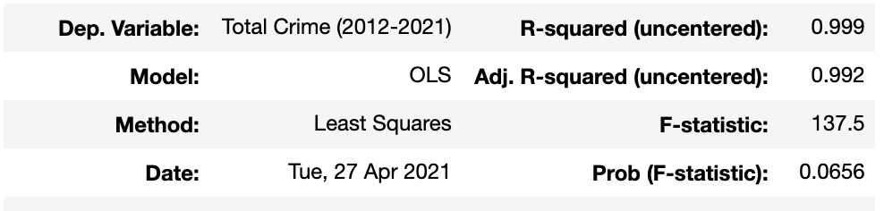
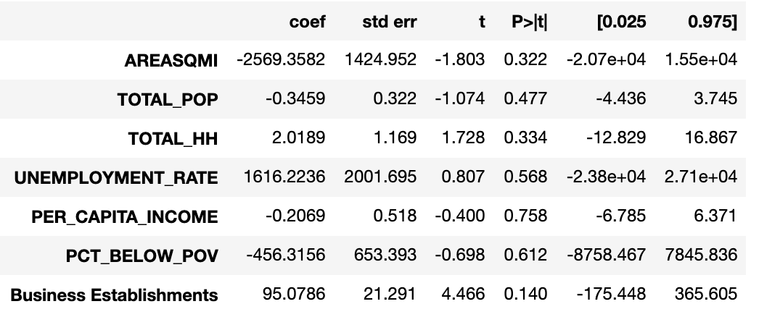
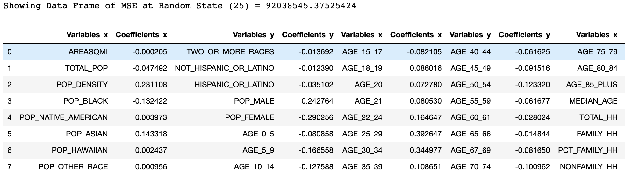
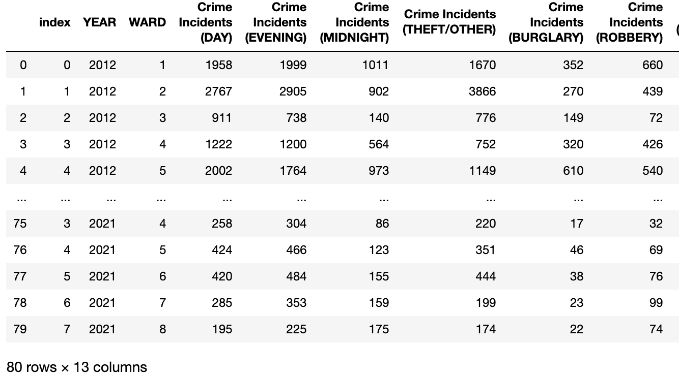
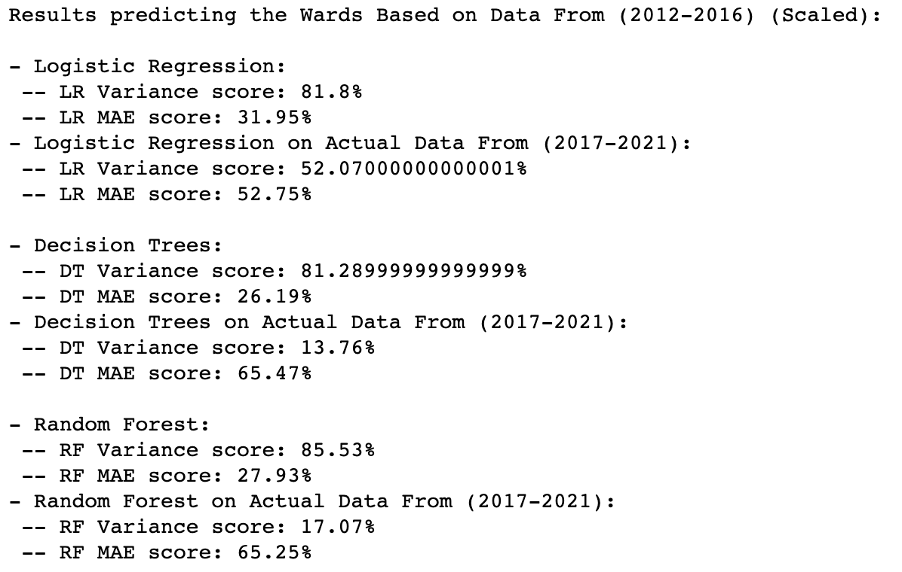
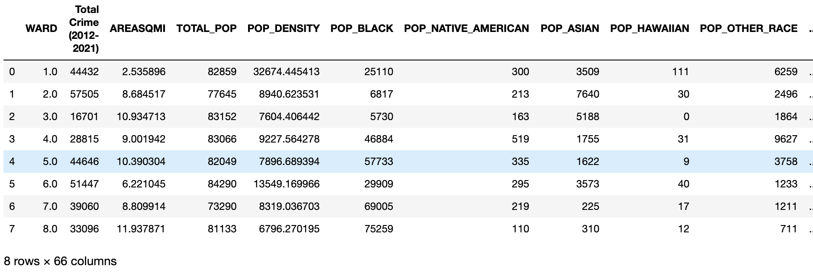
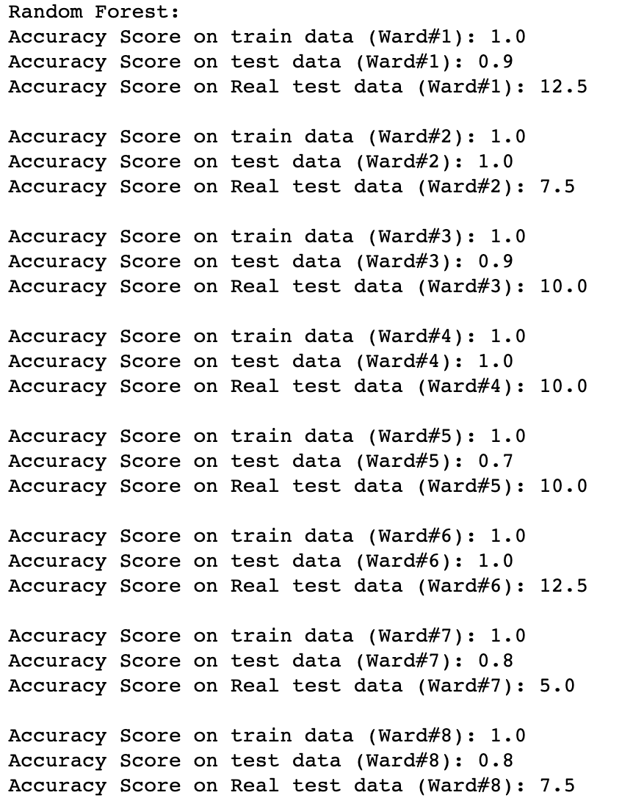
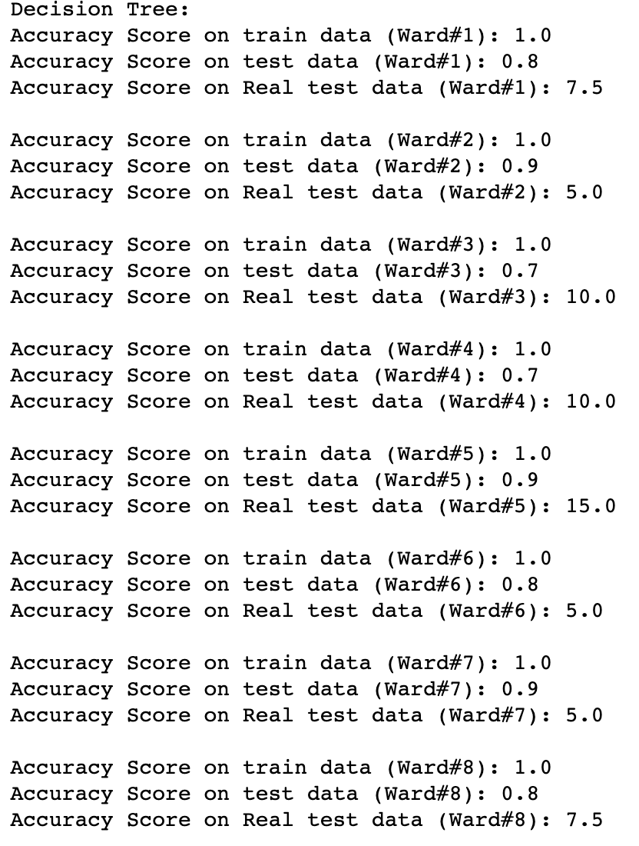
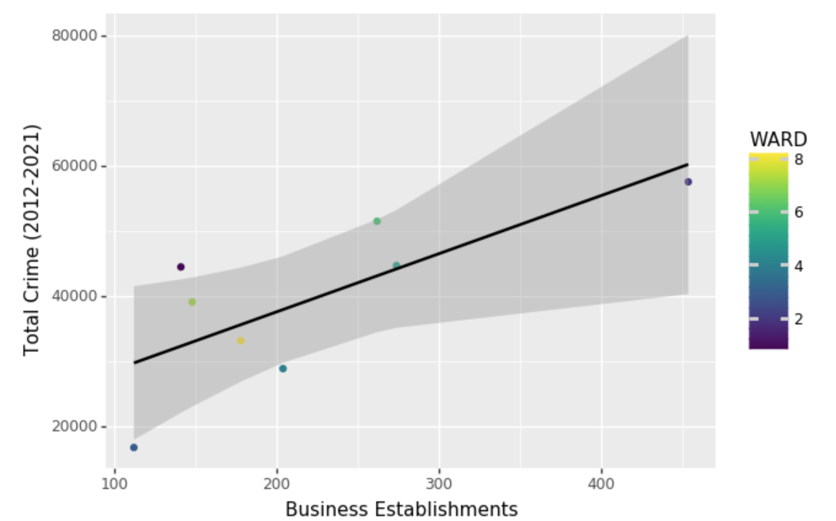
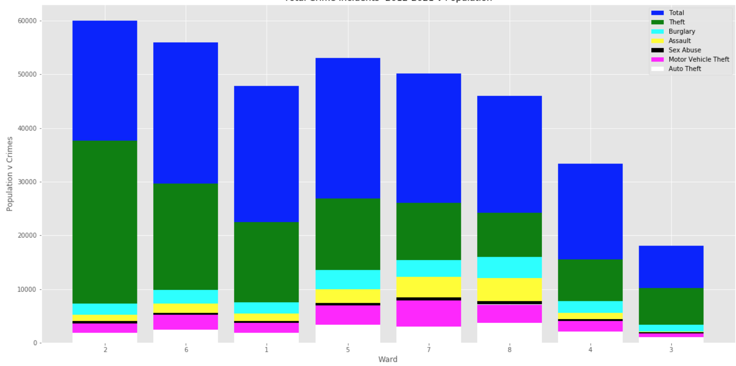
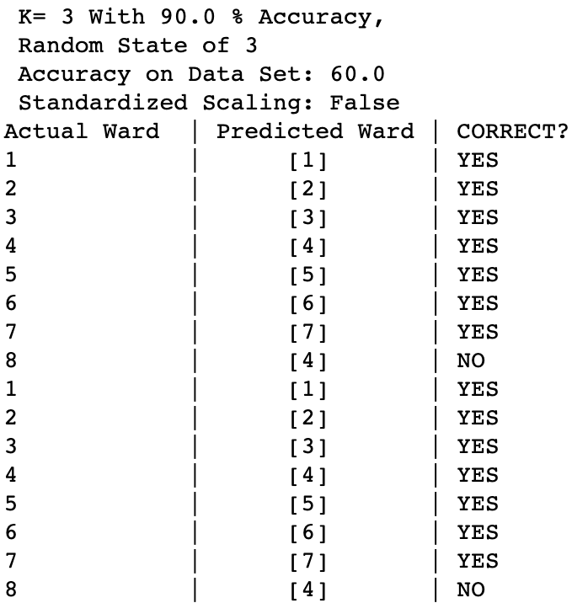
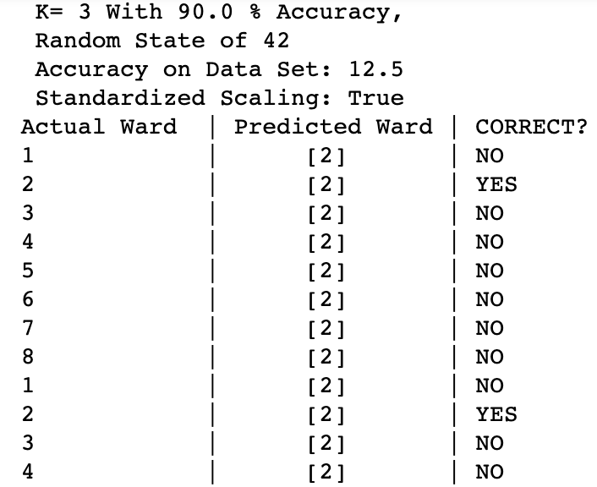

Analysis of DC Crime Incident Open Data
William Brandon Zabet
Student, M.S. Computer Science, The George Washington University
Abstract
Methodology
Results
Conclusion
Washington, D.C. has a unique demographic, geography, and criminal justice system. Additionally, recent gentrification efforts have begun to transform the demographics in distressed neighborhoods, thus seeing a rise in population. With more people coming to live in the city it is important for to understand the trends in crime, and what can be done to make the city safer. The District of Columbia is separated by eight distinct regions (wards) where the boundaries are defined and redistricted every ten years. With each ward being distinguished, it is possible to analyze the data pertaining to each ward to look for data that could possibly tell the story of crime for each area.
For this project, 12 data sets were manipulated, 10 of them were crime incidents from 2012-2021, and the last pertained to demographics, education, and economic data. All of the datasets were merged into two: one just relating to crime per ward, and one relating to the other variables along with the total crime per ward. No conclusive evidence was found towards an explanation. The results are discussed in the conclusion.
For the analysis, publicly available datasets on the District of Columbia’s Open Data website are used. All the data manipulation and techniques were used with Python on Jupyter Lab with various packages. With the wards being redistricted every decade, DC crime incidents for each year are used starting with the year 2012 as that was when it was last redistricted. For each year (2012 – 2021), the data sets consisted of subsets of locations and attributes of incidents reported in the ASAP (Analytical Services Application) crime report database by the District of Columbia Metropolitan Police Department (MPD).
. Additionally, datasets pertaining to education, economic, and demographic data per ward were used for the analyses. The most recent data available titled ‘Ward from 2012’, contained the information on D.C.’s 2012 election wards for the D.C. Office of the Chief Technology Officer (OCTO) and participating government agencies. This dataset contained relevant information such as area of the wards in square miles, population, households, unemployment rate, per capita income, and percent below poverty. Lastly, to further the exploration, data on Certified businesses enterprises in the District of Columbia as identified by the DC Department of Small and Local Business was used. The data was manipulated in different ways as python functions to select certain year ranges could be employed to see if results were more accurate as opposed to looking at a ten-year span of crime data and trying to generalize the findings based on the other data which doesn’t get updated every year. Each variable chosen was grouped by the number of instances on the dataset per ward. The following machine learning techniques were used for analysis: KNN, Kmeans, LR, Random Forest, Decision Trees, and NB.
From the first figure in the results, we can see that the multiple linear regression model has an r squared value of 0.99, provisionally indicating that this model explains 99.99% of the variance in our dependent variable. As the exploratory variables increase by one, the dependent variable decreases by 2569.36, decreases by 0.346, increases by 2.019, increases by 1616.224, decreases by 0.207, decreases by 456.316, and increases by 95.079 respectively. There are no significant p values. The f statistic was significantly low at 0.0656. Consequentially, we fail to reject the null hypothesis that the independent variables can predict the dependent variable. Consequentially, we fail to reject the null hypothesis that the independent variables can predict the dependent variable when running a multiple linear regression model. For every other multiple linear regression model, the outcome was the same. It appears that the random forest and decision tree models were promising as they would consistently predict the correct ward with at least 80% accuracy. However, it this would only be on the training data and when put up to the test on actual real-world data, the accuracy was much lower. All in all, no significant results were found and therefore we can't make any conclusions. This may be due to the limitations of data out there. The only constantly updated data available is the crime incident reports and and there are many factors that can be explored to potentially find significant results. Regarding the basic demographic data, it was last updated in 2012 so it certainly would help if there was more recent data. Additionally, the analyses had many shortcomings as only data from the span of ten years and total numbers were assessed. Essentially, the data was generalized. Future research should go deeper into the analyses of crime trends per ward by looking at distinct types of crime along with possibly analyzing the data on race populations per ward (which is fortunately available on the ‘Ward From 2012’ dataset). These steps could potentially explain the variation of crime between wards in DC. This research was a step in the right direction. However, after analyzing all the data, I found no conclusive evidence that any of the exploratory variables could predict the number of crime incidents reported per ward.
Introduction
It is known that crime rates are much higher in big cities than as opposed to small cities, towns, or rural areas. With a population of over six hundred thousand, it is no surprise that crime is pervasive in the District of Columbia. Washington D.C. is ranked as the 16th most dangerous place in America (Taylor & Staff, 2018). It has a violent crime rate that is 141% higher than the national average and a property crime rate that is 76% higher than the national average (2). While data on crime is ever persistent thanks to the exponential growth of technology, data on crime and rankings don’t necessarily tell the exact story. Major cities that have significant segregation, poverty, and inequality usually have high rates of violence, but it is concentrated within specific areas of the city (communities, blocks, neighborhoods, etc.); where these areas will vary on the rates of crime.
Washington, D.C. has a unique demographic, geography, and criminal justice system. Additionally, recent gentrification efforts have begun to transform the demographics in distressed neighborhoods, thus seeing a rise in population. With more people coming to live in the city it is important for to understand the trends in crime, and what can be done to make the city safer. The District of Columbia is separated by eight distinct regions (wards) where the boundaries are defined and redistricted every ten years. With each ward being distinguished, it is possible to analyze the data pertaining to each ward to look for data that could possibly tell the story of crime for each area.
References
https://opendata.dc.gov/
https://www.areavibes.com/washington-dc/crime/
Taylor, D. Staff, P. (2018). DC Is America's 16th Most Dangerous City: A review of 2017 crime data ranks the most dangerous big cities in America. See how D.C. fared. Patch.com

